Slide 1
Professional Certificate Programme in Agentic AI and Applications

Slide 2
Data Types, Variables, Control Flow & Functions
VIT_POC - Documents - IITM_New Updates - All Documents
VIT_POC - Documents - IITM_New Updates - All Documents

Slide 3
Revisit the Learning So Far
Let’s take a quick look at the key ideas and concepts you have explored in your learning journey.
How AI has evolved over time, from early rule-based systems to today’s intelligent models
What Agentic AI is and how autonomous, goal-driven systems differ from traditional approaches
The key limitations and advantages of current AI technologies in practical use
Real-world examples demonstrating how Agentic AI is applied across industries
The core components that enable Agentic AI systems to plan, reason and act independently
How to get started with ChatGPT and Python for building simple AI-driven workflows
The basics of writing Python scripts to automate tasks and interact with AI tools

Slide 4
Revisit the Learning So Far
Let’s take a quick look at the key ideas and concepts you have explored in your learning journey.
How to prompt, debug and reflect effectively when working with ChatGPT
The principles of prompt engineering for clearer, more accurate AI responses
How to use AI tools to support debugging and improve problem-solving efficiency
A group exercise designed to practise prompting, collaboration and applied AI skills
Common pitfalls when using ChatGPT and how to avoid them
An activity session to consolidate learning through hands-on exploration

Slide 5
Topics Covered
Python Basics: Variables, Data Types & Numbers
Python Data Structures: Building Blocks for Efficient Programming
Lists
Tuples
Sets
Dictionaries
Python Conditional Statements

Slide 6
Topics Covered
Loops in Python: Automating Repetitive Tasks​
Building a Simple Chatbot in Python​
Recap
Python User-Defined Functions​
Example: Chatbot with Function

Slide 7
Python Fundamentals
Notes:
Script for video with pronunciation guide:
<<This is the section where the script for the video will be detailed. Include pronunciation guide and audio keys for technical terms>>
Developer Notes:
<<Use this space to provide important notes and instructions for the development team. This may include technical specifications, transitions, or any other relevant information that needs to be considered during production.>>
Visual reference:
<<Insert visual references here. These could be links to images for recreation purposes. Ensure that each visual corresponds to the relevant part of the script to guide the visual design process effectively.>>

Slide 8
Python Basics: Variables, Data Types & Numbers
Foundation for writing and understanding Python programs
Key building blocks for data manipulation and analysis
(Topic 1 of 12)
Notes:
Python Basics: Variables, Data Types & Numbers
Foundation for writing and understanding Python programs
Key building blocks for data manipulation and analysis

Slide 9
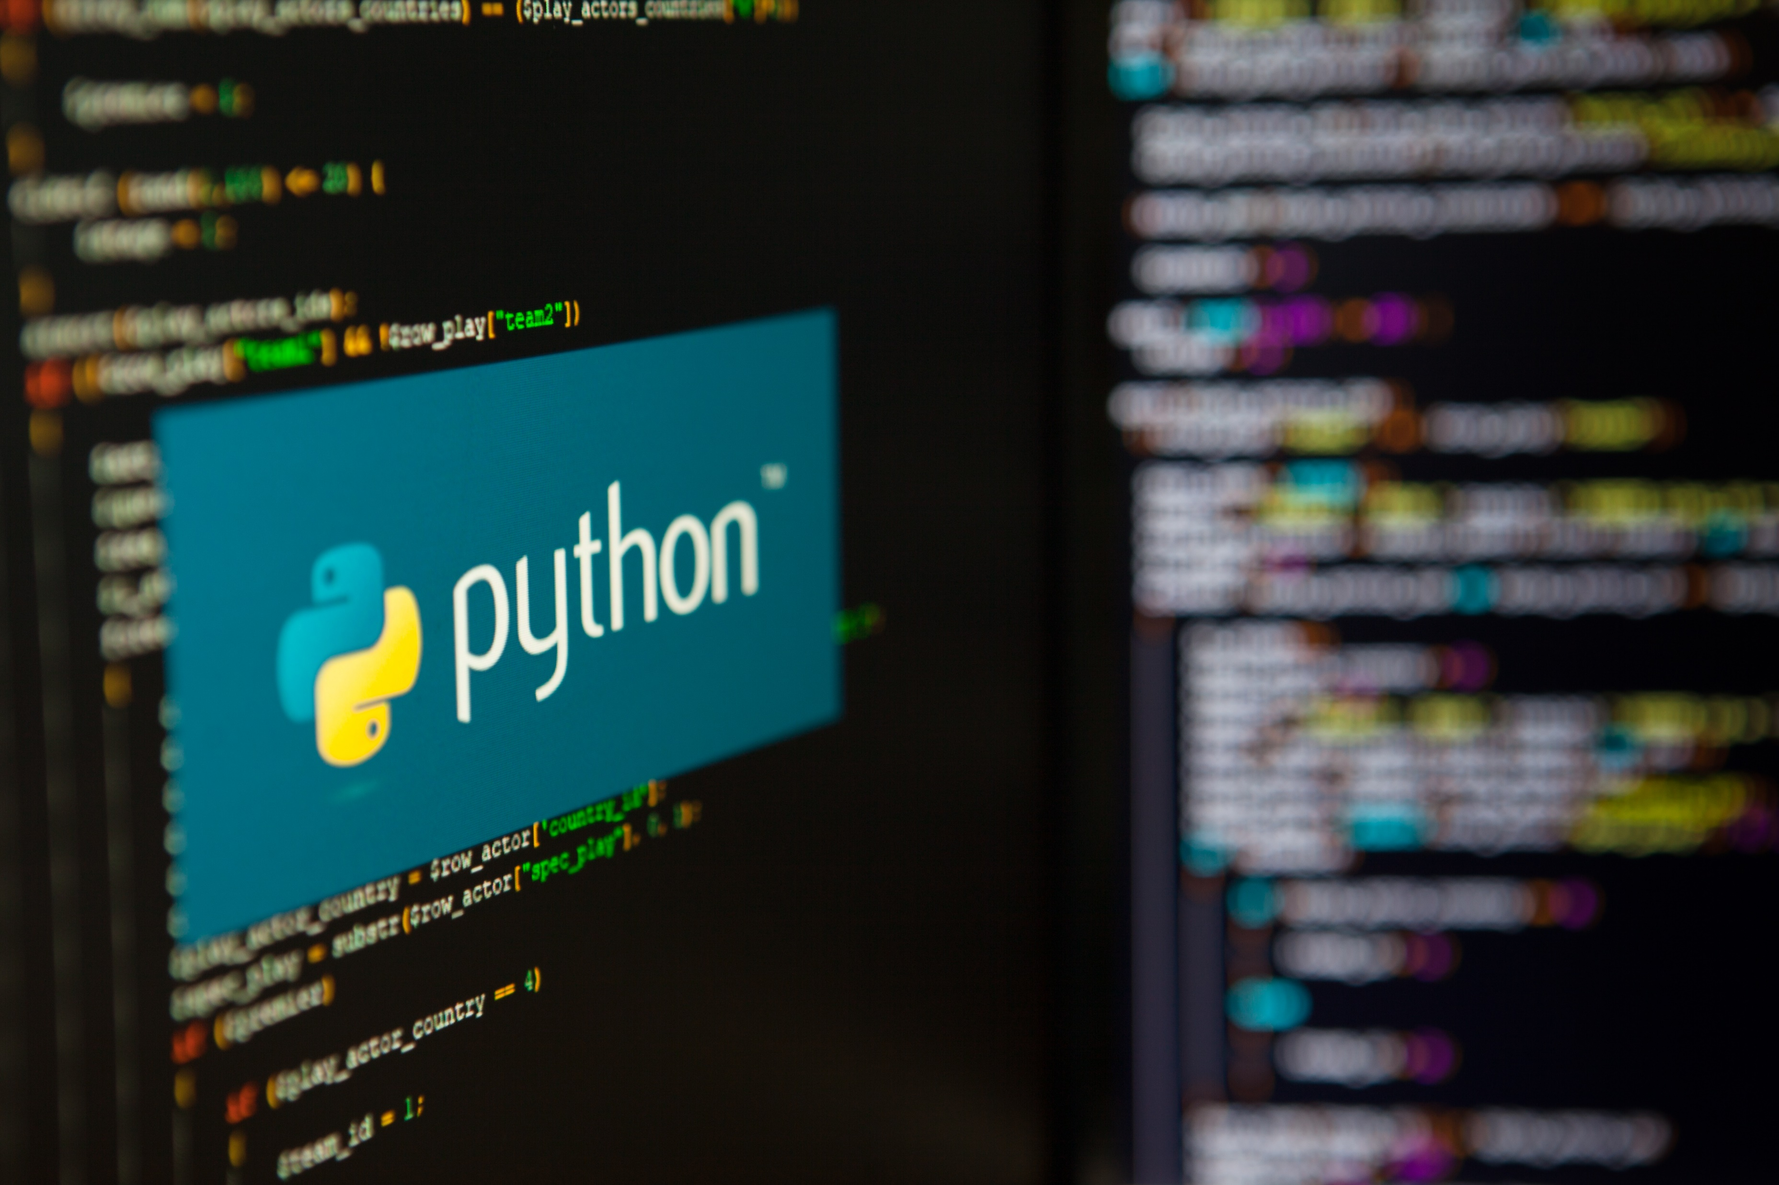
Introduction
Emphasises simplicity and readability
Treats everything as an object
Notes:
Introduction
Python is widely used because of its simplicity and readability Everything in Python is an object
Remove the icons from the infographics
Repository Slide no: 43
https://image.shutterstock.com/z/stock-photo-saint-petersburg-russia-july-programming-language-python-inscription-on-the-background- 1447245065.jpg

Slide 10



Key Concepts in Python
Variables
Data types
Numbers
Notes:
Before diving into advanced topics, we must understand:
Variables
Data Types
Numbers
Variables: https://enterprise.shutterstock.com/image-vector/programming-coding-outline-icons-collection-scripting- 2292020475 ( 5th icon in row 3)
Data Types: https://enterprise.shutterstock.com/image-vector/programming-coding-outline-icons-collection-scripting- 2292020475 ( 5th icon in row 4)
Numbers: https://enterprise.shutterstock.com/image-vector/programming-coding-outline-icons-collection-scripting -2292020475 ( last icon in row 2)
Repository Slide no: 29

Slide 11


Variables in Python
Definition
Store values using a name (no type declaration needed; Python is dynamically typed)
Syntax
Naming rules
Start variable names with a letter or underscore, not a number
Notes:
Variables in Python
Definition: A variable is a name that stores a value.
No need to declare type (Python is dynamically typed).
Syntax:
x = 10 name = "Arjun“ ( image : slide number 5)
Variable names must start with a letter or underscore, not a number.
Image:
https://image.shutterstock.com/image-photo/programming-language-concept-system-engineering-260nw- 1404621860.jpg

Slide 12



Rules & Conventions for Variables
Use letters, numbers and underscores (e.g. student_name)
Avoid reserved keywords (e.g. for, class)
Distinguish between cases (Age ≠ age)
Choose descriptive names to improve readability
Notes:
Rules & Conventions for Variables
Allowed
Letters, numbers, underscore (student_name)
Not allowed
Keywords (for, class)
Case-sensitive
Age and age are different
Use descriptive names
Improves readability
SSID:
Icon 1: https://www.shutterstock.com/image-vector/like-dislike-icons-set-thumbs-down- 777983098 (Left icon)
Icon 2: https://www.shutterstock.com/image-vector/like-dislike-icons-set-thumbs-down- 777983098 (Right icon)
Icon 3: https://www.shutterstock.com/image-vector/compare-icon-symbol-collection-on-white- 2543288745
Icon 4: https://www.shutterstock.com/image-vector/readability-icon-content-clarity-easy-read- 2665387637
Repository Slide no: 85

Slide 13
Built-in Data Types in Python
Numeric
Sequence
Represent numbers using int, float or complex
Stores ordered data using str
str, list, tuple
Mapping
Set types
Link keys to values using dict
Hold unique items using set
Set or frozenset
Boolean
Express truth values using True / False
None
Indicate absence of value using None
Notes:
Data Types in Python
Python has several built-in data types:
Numeric
int, float, complex
Sequence
str, list, tuple
Mapping
Dict
Set Types
set, frozenset
Boolean
True / False
None
represents no value
Image:
Remove the icons in the infographics
Repository Slide no: 44

Slide 14

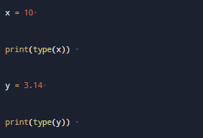
Checking Data Types
Use type() function:
Notes:
Checking Data Types
Use type() function:
x = 10 print(type(x)) y = 3.14 print(type(y))
Image:
https://image.shutterstock.com/image-photo/employees-must-complete-online-survey-260nw- 2179662609.jpg
slide number 8

Slide 15



Numbers in Python
Integers (int)
Whole numbers e.g., 10,-5,200
Floats (float)
Decimal numbers, e.g., 3.14, -2.5
Complex numbers (complex)
𝑎 + 𝑏𝑗 form, e.g., 3 + 5j
Notes:
Numbers in Python
Integers (int)
Whole numbers → 10, -5, 200
Floats (float)
Decimal numbers → 3.14, -2.5
Complex numbers (complex)
a + bj form → 3 + 5j
Repository Slide no: 91

Slide 16
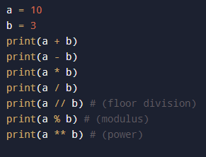
Number Operations
Basic Arithmetic
Notes:
Number Operations
Basic arithmetic:
a = 10 b = 3 print(a + b) print(a - b) print(a * b) print(a / b) print(a // b) # (floor division)print(a % b) # (modulus) print(a ** b) # (power)
image: Slide Number: 10

Slide 17
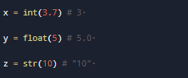
Type Conversion
Convert Between Types Using Built-in Functions:
Notes:
Type Conversion
Convert between types using built-in functions:
x = int(3.7) # 3 y = float(5) # 5.0 z = str(10) # "10“
Image: Slide number 11

Slide 18
Python Data Structures: Building Blocks for Efficient Programming
(Topic 2 of 12)

Slide 19
Data Structures in Python
Organise data based on your specific needs
Enable efficient storage, access and manipulation of data
Notes:
Understanding Data Structures
Imagine organizing your bookshelf. You have different types of books: novels, textbooks, comics, and magazines. Each type needs a different way to be arranged.
In Python, data structures are like different ways to organize data based on your needs. They help you store, access, and manipulate data efficiently.
Image:
https://image.shutterstock.com/image-photo/programming-language-concept-system-engineering-260nw- 1404621860.jpg

Slide 20




Types of Data Structures in Python
Tuples
Lists
An immutable collection, like an ID card with unchangeable personal information
An ordered collection where items can be added or removed
Dictionaries
Sets
A collection of key-value pairs, like a real-world dictionary, where a word (key) has a meaning (value)
A collection of unique items, like a box of toys where order does not matter
Notes:
Types of Data Structures in Python
Lists
Think of a list as a grocery list. It's an ordered collection of items, and you can add or remove items as needed.
Tuples
Imagine an ID card. It contains personal information that shouldn't change. A tuple is like that—an immutable list.
Sets
Think of a set as a box of unique toys. You don't care about the order, but each toy is unique.
Dictionaries
A dictionary is like a real-world dictionary: you have a word (key) and its meaning (value).
Image:
These icons were taken form the slide deck
Repository Slide no: 80

Slide 21
Comparing Data Structures
Data structure | Characteristics
Lists | Ordered, changeable, allows duplicates
Tuples | Ordered, unchangeable, allows duplicates
Sets | Unordered, unique, no duplicates
Dictionaries | Key-value pairs, fast lookups and retrievals
Notes:
Comparing Data Structures
Lists
Ordered, changeable collections that allow duplicates
Tuples
Ordered, unchangeable collections that allow duplicates
Sets
Unordered, unique collections with no duplicates
Dictionaries
Key-value pairs for fast lookups and retrievals

Slide 22
Lists
Python's most versatile data structure
(Topic 3 of 12)

Slide 23






Introduction to Lists in Python
A Dynamic, Adjustable Collection
Ordered
Elements have a defined order, accessible by index
Mutable
Can be modified (add, remove, change items)
Versatile
Supports duplicates and mixed data types
Notes:
Introduction to Lists
A list in Python is like a dynamic collection of items. Imagine a to-do list that you can keep adding to, rearranging, or checking off as you complete tasks.
Features of Lists
Ordered
Elements maintain their position and can be accessed by index
Mutable
Can be modified after creation (add, remove, or change items)
Versatile
Allows duplicates and different data types in the same list
Image:
Repository Slide no: 40
Icon 1: https://www.shutterstock.com/image-vector/folder-archive-cabinet-drawer-isolated-minimal- 331309859 (First icon)
Icon 2: https://www.shutterstock.com/image-vector/edit-icon-vector-files-editable-stroke- 2566391277
Icon 3: https://www.shutterstock.com/image-vector/versatile-icon-multifunction-sign-arrows-pointing- 2394285387

Slide 24
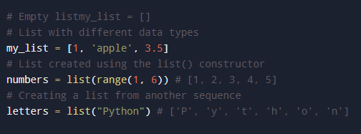
Creating Lists in Python
Start Empty or Initialise with Items
Lists use square brackets [ ] and can contain any data type, including other lists.
Notes:
Creating Lists
Creating a list in Python is simple. You can start with an empty list or initialize it with some items.
# Empty listmy_list = []# List with different data typesmy_list = [1, 'apple', 3.5]# List created using the list() constructornumbers = list(range(1, 6)) # [1, 2, 3, 4, 5]# Creating a list from another sequenceletters = list("Python") # ['P', 'y', 't', 'h', 'o', 'n’].
Lists are represented by square brackets [] and can hold any type of data, even other lists!
Image: Slide number 18

Slide 25

Accessing List Elements
Ordered Collections: Access items using their index (zero-based)
Example:
Notes:
Accessing List Elements
Lists are ordered collections, which means you can access items using their index (position in the list). Python uses zero-based indexing.
fruits = ['apple', 'banana', 'cherry’]print(fruits[0]) # Output: appleprint(fruits[-1]) # Output: cherry
Image: Slide number: 19

Slide 26
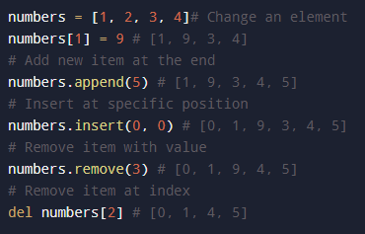
Modifying List Elements
Lists are mutable, allowing you to change their content without creating a new list.
Notes:
Modifying List Elements
Lists are mutable, which means you can change their content without creating a new list.
numbers = [1, 2, 3, 4]# Change an element numbers[1] = 9 # [1, 9, 3, 4] # Add new item at the end numbers.append(5) # [1, 9, 3, 4, 5] # Insert at specific position
numbers.insert(0, 0) # [0, 1, 9, 3, 4, 5] # Remove item with value numbers.remove(3) # [0, 1, 9, 4, 5] # Remove item at index del numbers[2] # [0, 1, 4, 5]
Image: Slide number 20

Slide 27
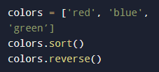


Common List Operations
Built-in Methods in Python
Sorting and reversing: Use sort() to sort and reverse() to reverse the list order.
Counting and finding: Use count()to count occurrences and index()to find the index of an item.
Adding and extending: Use extend() to add elements from another list.
Notes:
Common List Operations
Python provides several built-in methods to perform operations on lists. These can help sort, reverse, count, and more.
Sorting and reversing
colors = ['red', 'blue', 'green’]colors.sort() colors.reverse()
Counting and Finding
numbers = [1, 2, 3, 2, 1] count = numbers.count(2) index = numbers.index(3)
Adding and Extending
list1 = [1, 2, 3] list2 = [4, 5] list1.extend(list2)
Image: Slide number: 21

Slide 28
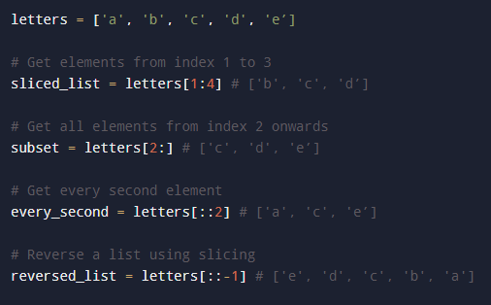
Slicing Lists in Python
Create a Sublist: Use list[start:stop:step] to create a new list from a subset of elements.
Slicing creates a new list without modifying the original, preserving your data.
Notes:
Slicing Lists
Slicing allows you to create a new list from a subset of elements from an existing list. The syntax is list[start:stop:step].
letters = ['a', 'b', 'c', 'd', ‘e’] # Get elements from index 1 to 3 sliced_list = letters[1:4] # ['b', 'c', ‘d’] # Get all elements from index 2 onwards
subset = letters[2:] # ['c', 'd', ‘e’] # Get every second element every_second = letters[::2] # ['a', 'c', ‘e’] # Reverse a list using slicing reversed_list = letters[::-1] # ['e', 'd', 'c', 'b', 'a']
Slicing creates a new list without modifying the original, making it safe for preserving your data.
Image: Slide number 22

Slide 29
Tuples
Immutable collections for data that shouldn't change
(Topic 4 of 12)
Notes:
Group Exercise

Slide 30
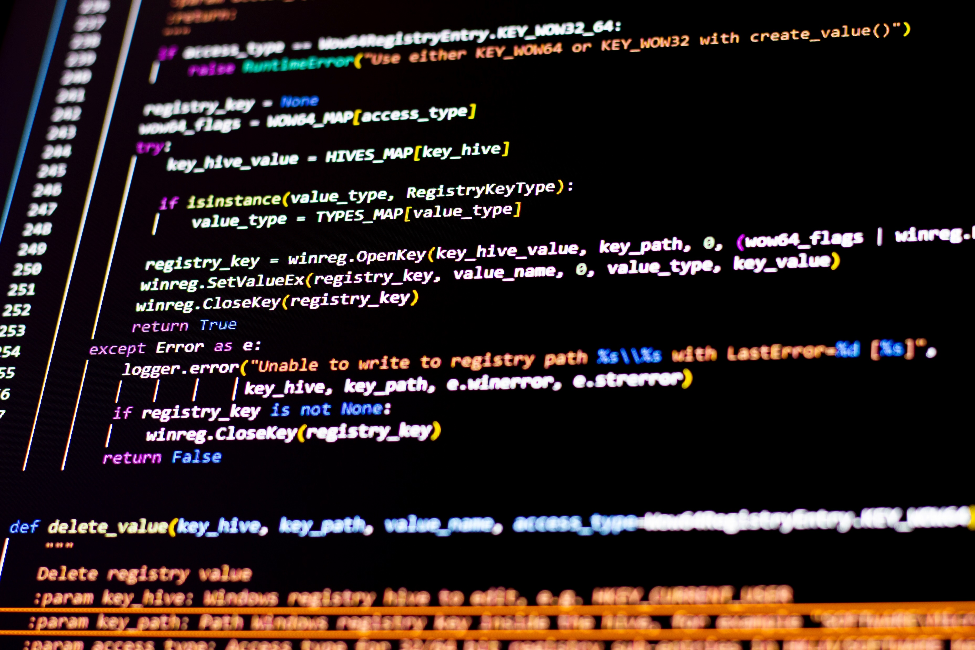
Tuple in Python
An Ordered, Immutable Collection
Think of a tuple like an ID card. Once it's created, the information on it cannot be changed.
Ordered
Items have a specific order that does not change
Immutable
Cannot be modified after creation
Versatile
Can contain mixed data types (integers, strings, etc.)
Notes:
What is a Tuple in Python?
Think of a tuple like an ID card. Once it's created, the information on it cannot be changed.
In Python, a tuple is an ordered, immutable collection of items.
Ordered
Items have a specific order that doesn't change
Immutable
Cannot be modified after creation
Versatile
Can contain mixed data types (integers, strings, etc.)
Image: (Remove the icons from it.)
Infographic Repository Slide 44
https://enterprise.shutterstock.com/catalog?q=python

Slide 31
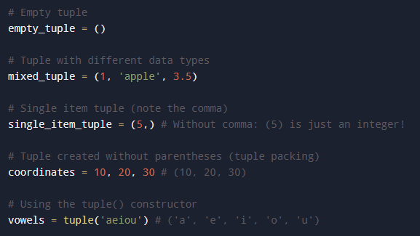
Creating a Tuple
Creating a tuple is like creating a list, but with parentheses () instead of square brackets [].
For a single-item tuple, include a trailing comma after the value.
Notes:
How to Create a Tuple
Creating a tuple is similar to creating a list, but you use parentheses () instead of square brackets [].
# Empty tuple empty_tuple = () # Tuple with different data types mixed_tuple = (1, 'apple', 3.5) # Single item tuple (note the comma) single_item_tuple = (5,) # Without comma: (5) is just an integer! # Tuple created without parentheses (tuple packing) coordinates = 10, 20, 30 # (10, 20, 30) # Using the tuple() constructor vowels = tuple('aeiou') # ('a', 'e', 'i', 'o', 'u')
Remember: For a single-item tuple, you must include a trailing comma after the value!
Image: Slide number 25

Slide 32




Key Characteristics of Tuples
Immutability
Dictionary keys
Prevents modification, addition, or removal of elements, ensuring data integrity
Can serve as dictionary keys if containing only immutable elements
Performance
Multiple return values
Provides faster iteration and access due to fixed size in memory
Allows returning multiple values from functions
Notes:
Characteristics of Tuples
Immutability
Once created, elements can't be modified, added, or removed, providing data integrity
Performance
Faster than lists for iteration and access due to their fixed size in memory
Dictionary Keys
Can be used as dictionary keys if they contain only immutable elements
Multiple Return Values
Perfect for returning multiple values from functions
Icon 1:https://enterprise.shutterstock.com/image-vector/line-icon-open-book-padlock-representing- 2640586701
Icon 2:https://enterprise.shutterstock.com/image-vector/set-60-line-icons-related-productivity- 2294598813
Icon 3 https://enterprise.shutterstock.com/image-vector/application-icons- 138025259
Icon 4:https://enterprise.shutterstock.com/image-vector/mortgage-rate-money-credit-finance-payroll- 2258738853
Repository Slide no: 81

Slide 33
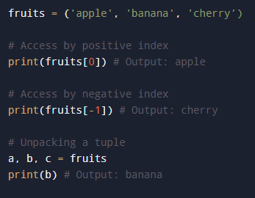
Accessing Tuple Elements
Tuples are ordered like lists, allowing element access via indexing, with identical syntax.
Tuple unpacking allows assigning multiple variables simultaneously.
Notes:
Accessing Tuple Elements
Like lists, tuples are ordered, so you can access elements using their index. The syntax is identical to list indexing
fruits = ('apple', 'banana', 'cherry’) # Access by positive index print(fruits[0]) # Output: apple # Access by negative index
print(fruits[-1]) # Output: cherry # Unpacking a tuple a, b, c = fruits print(b) # Output: banana
Tuple unpacking is a powerful feature that allows you to assign multiple variables at once.
Image: Slide number 27

Slide 34
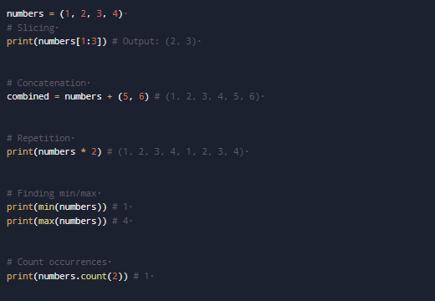
Tuple Operations
Tuples are immutable but support slicing, concatenation and repetition.
Tuples can't be modified directly but can be recreated from existing ones.
Notes:
Tuple Operations
While tuples are immutable, you can perform various operations such as slicing, concatenation, and repetition.
numbers = (1, 2, 3, 4) # Slicing print(numbers[1:3]) # Output: (2, 3) # Concatenation combined = numbers + (5, 6) # (1, 2, 3, 4, 5, 6) # Repetition print(numbers * 2) # (1, 2, 3, 4, 1, 2, 3, 4) # Finding min/max print(min(numbers)) # 1 print(max(numbers)) # 4 # Count occurrences print(numbers.count(2)) # 1
Although you can't change a tuple directly, you can create new tuples based on existing ones.
Image: Slide number 28

Slide 35
When to Use Tuples v. Lists
You need to modify the collection after creation | Your data should not change (constants)
You want to add or remove items | You need dictionary keys
Your data needs to be sorted or rearranged | You want slightly better performance
You're collecting user input or growing a collection | You're returning multiple values from a function and ensuring data integrity
Use lists when
Use tuples when
Notes:
When to Use Tuples vs. Lists
Use Lists When:
You need to modify the collection after creation
You want to add or remove items
Your data needs to be sorted or rearranged
You're collecting user input or growing a collection
Use Tuples When:
Your data should not change (constants)
You need dictionary keys
You want slightly better performance
You're returning multiple values from a function
You need to ensure data integrity

Slide 36
Sets
(Topic 5 of 12)

Slide 37
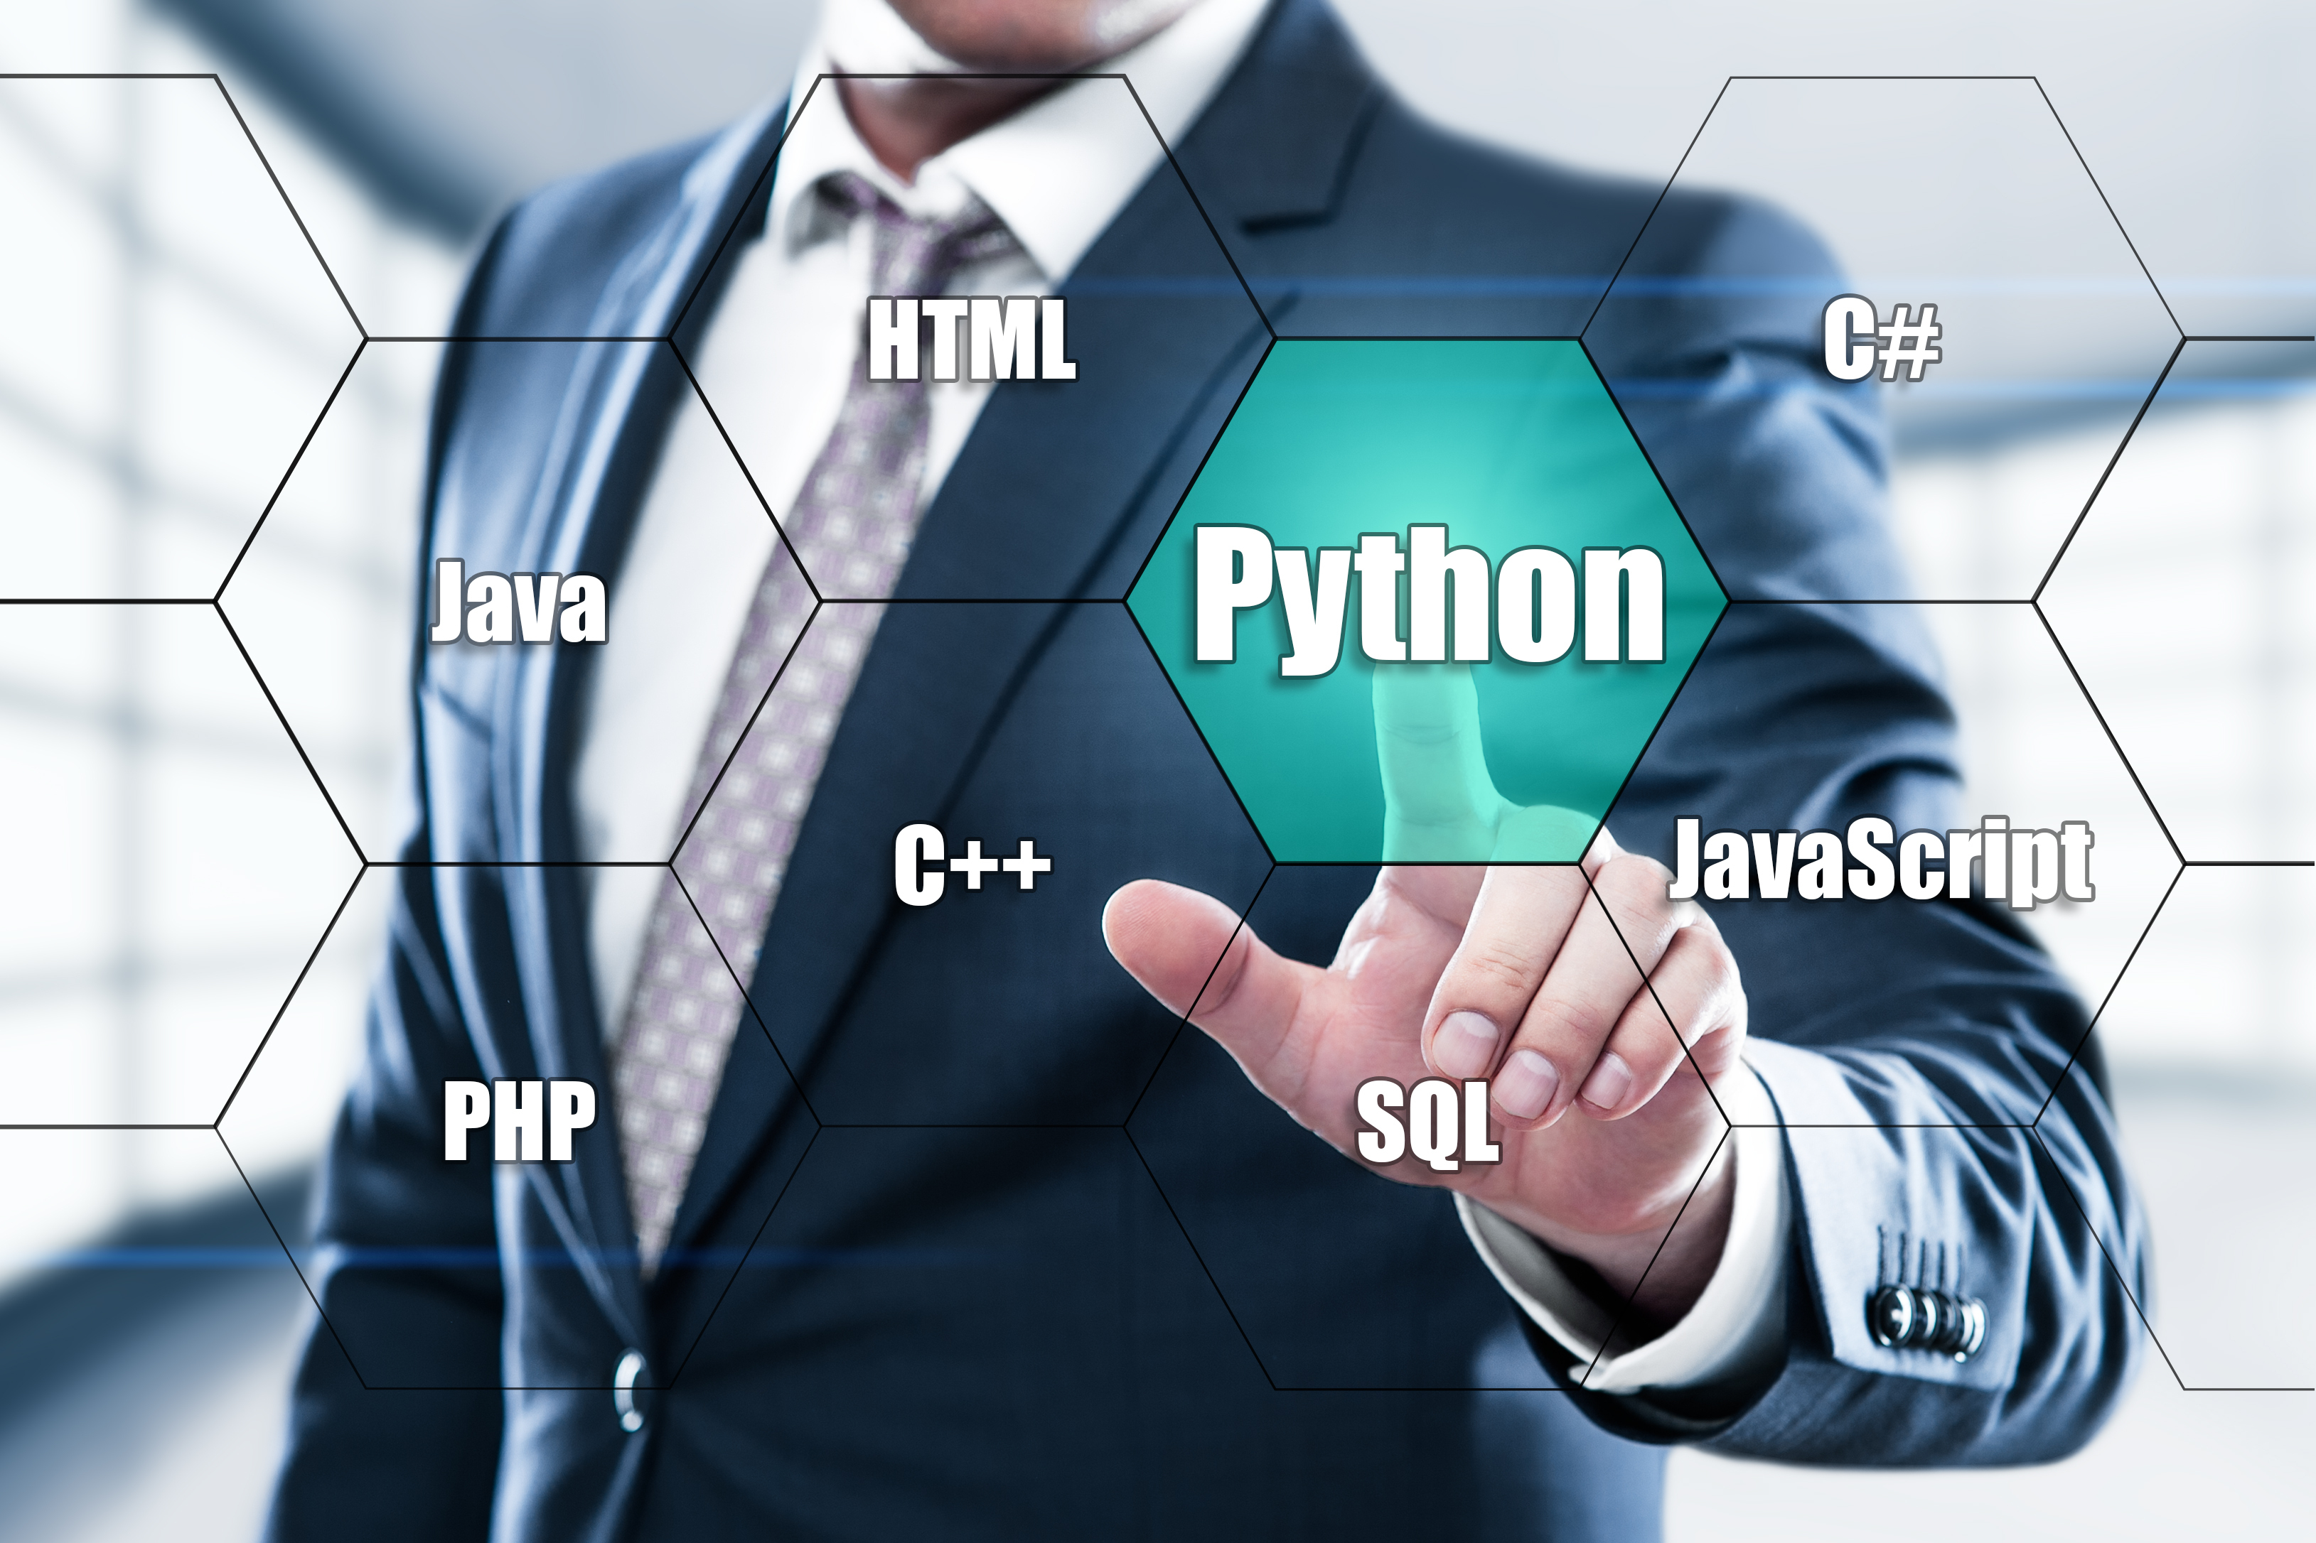
Set in Python
A Collection of Unique, Unordered Items
Unordered collection
Elements have no specific order and cannot be accessed by index
No duplicate elements
Duplicates are removed, and each element appears only once
Mutable
Elements can be added or removed after the set is created
Notes:
What is sets in Python
Imagine a set as a bag of unique items where the order doesn't matter, and there are no duplicates. This is similar to a set in mathematics, where each element is unique.
Features of Sets
Unordered collection
Elements have no specific order or position, so you can't access them by index
No duplicate elements
Each element appears exactly once - duplicates are automatically removed
Mutable
You can add or remove elements after creating the set
Image:
https://enterprise.shutterstock.com/catalog?q=python
Infographic Repository Slide 91

Slide 38
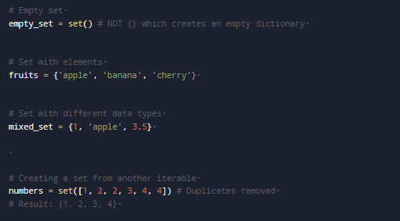
Creating a Set in Python
Use curly braces { } or the set( ) function.
Use set( ) to create an empty set, not { }, which creates an empty dictionary.
Notes:
How to Create a Set
Creating a set in Python is straightforward. You can initialize a set using curly braces {} or the set() function.
# Empty setempty_set = set() # NOT {} which creates an empty dictionary# Set with elements fruits = {'apple', 'banana', 'cherry’} # Set with different data types mixed_set = {1, 'apple', 3.5} # Creating a set from another iterable numbers = set([1, 2, 2, 3, 4, 4]) # Duplicates removed # Result: {1, 2, 3, 4}
Note: To create an empty set, you must use set(), not {} (which creates an empty dictionary).
Image: Slide number: 32

Slide 39
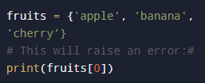

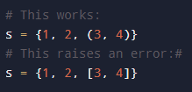
Key Properties of Sets
Unique Characteristics Compared to Lists and Tuples
Unordered
Elements have no specific order, making indexing or slicing impossible.
Unique elements
Duplicates are automatically removed when creating a set.
Mutable with restrictions
Sets are mutable, but can only contain immutable elements.
Notes:
Properties of Sets
Sets have unique characteristics that differentiate them from other data structures like lists and tuples.
Unordered
Elements in a set have no specific order, making indexing or slicing impossible:
fruits = {'apple', 'banana', 'cherry’} # This will raise an error:# print(fruits[0])
Unique Elements
Duplicates are automatically removed when creating a set
numbers = set([1, 2, 2, 3, 3, 3]) print(numbers) # {1, 2, 3}
Mutable but with Restrictions
Sets can be modified, but can only contain immutable elements:
# This works: s = {1, 2, (3, 4)} # This raises an error:# s = {1, 2, [3, 4]}
Image: Slide number 33

Slide 40
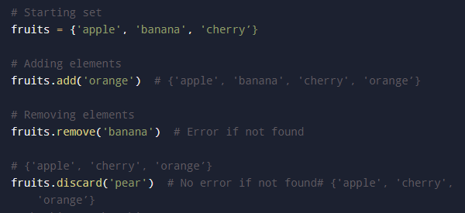
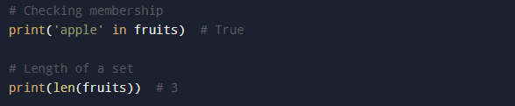
Common Operations on Sets
Operations for Adding, Removing and Checking Membership
Key difference: remove() raises a KeyError if the element is not found, while discard()does nothing.
Notes:
Common Operations on Sets
Python sets support various operations for adding, removing, and checking membership.
# Starting set fruits = {'apple', 'banana', 'cherry’} # Adding elements fruits.add('orange') # {'apple', 'banana', 'cherry', 'orange’} # Removing elements fruits.remove('banana') # Error if not found # {'apple', 'cherry', 'orange’} fruits.discard('pear') # No error if not found# {'apple', 'cherry', 'orange’} # Checking membership print('apple' in fruits) # True # Length of a set print(len(fruits)) # 3
Key Difference: remove() raises a KeyError if the element isn't found, while discard() quietly does nothing.
Image: Slide number 34

Slide 41
Other Useful Methods
pop()Removes and returns an arbitrary element
clear() - Deletes all elements
copy() - Returns a shallow copy
Notes:
Other useful methods include:
pop() - Removes and returns an arbitrary element
clear() - Removes all elements
copy() - Returns a shallow copy
Image:
Infographic Repository Slide 91

Slide 42
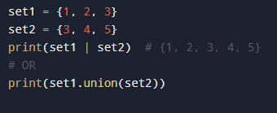

Mathematical Operations on Sets
Operations for Comparing and Combining Collections
Union
Combines elements from both sets:
Intersection
Contains elements common to both sets
Notes:
Mathematical Operations on Sets
Sets in Python can perform operations similar to mathematical set theory, making them perfect for comparing and combining collections.
Union
Combines elements from both sets:
set1 = {1, 2, 3}set2 = {3, 4, 5}print(set1 | set2) # {1, 2, 3, 4, 5}# OR print(set1.union(set2))
Intersection
Contains elements common to both sets:
print(set1 & set2) # {3}# OR print(set1.intersection(set2))
Images : Slide number 35

Slide 43


Mathematical Operations on Sets
Operations for Comparing and Combining Collections
Difference
Includes elements in first set but not in second
Symmetric difference
Encompasses elements in either set but not both
Notes:
Difference
Contains elements in first set but not in second:
print(set1 - set2) # {1, 2}# OR print(set1.difference(set2))
Symmetric Difference
Contains elements in either set but not both:
print(set1 ^ set2) # {1, 2, 4, 5} # OR print(set1.symmetric_difference(set2))
Images: Slide number 35

Slide 44


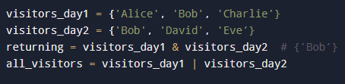
Use Cases of Sets
Removing duplicates
Membership testing
Finding unique or common elements
Sets provide O(1) time complexity for add, remove and membership tests, making them faster than lists.
Notes:
Use Cases of Sets
Sets are particularly useful when dealing with collections where uniqueness and membership are essential.
Removing Duplicates
items = ['apple', 'banana', 'apple', 'orange’] unique_items = set(items)# Output: {'orange', 'banana', 'apple'}
Membership Testing
fruits = {'apple', 'banana', 'cherry’}# Much faster than list for large collections print('banana' in fruits) # True
Finding Unique or Common Elements
visitors_day1 = {'Alice', 'Bob', 'Charlie’} visitors_day2 = {'Bob', 'David', 'Eve’} returning = visitors_day1 & visitors_day2 # {'Bob’} all_visitors = visitors_day1 | visitors_day2
Sets provide O(1) average time complexity for add, remove, and membership testing operations, making them significantly faster than lists for these operations when working with large data sets.

Slide 45



Limitations of Sets
No indexing or slicing
Elements cannot be accessed by position or sliced, making sets unsuitable for ordered data.
Cannot Store Mutable Elements
Only hashable (immutable) elements can be stored, excluding lists or other sets.
Silent Operations
Methods like discard() and update()do not raise errors for missing elements, which may hide logical issues.
Notes:
Limitations of Sets
No Indexing or Slicing
Unlike lists, you cannot access elements by position or extract subsets using slice notation. This makes sets unsuitable when order matters.
Cannot Store Mutable Elements
Sets can only contain hashable (immutable) elements. You cannot store lists or other sets directly as elements within a set.
Silent Operations
Methods like discard() and update() don't raise errors if elements aren't found, which may mask logical errors in your code.
Repository Slide no: 86
Icons have been take from the deck slide number: 37

Slide 46
Dictionaries
(Topic 6 of 12)

Slide 47




Dictionary in Python
Key-Value Pairs for Efficient Data Storage and Retrieval
Key-value pairs
Unordered (Pre-Python 3.7)
Each element consists of a key and its associated value
Traditionally unordered, though Python 3.7+ preserves insertion order
Mutable
Unique keys
Can add, modify, or remove key-value pairs
Keys must be unique and immutable, while values can be any type
Notes:
What is a Dictionary in Python?
Think of a dictionary as a real-world dictionary where each word (key) maps to its definition (value). In Python, a dictionary is a collection of key-value pairs, allowing you to store and retrieve data efficiently.
Key-Value Pairs
Each element consists of a key and its associated value, linked together
Unordered (Pre-Python 3.7)
Traditionally unordered, though Python 3.7+ preserves insertion order
Mutable
Can add, modify, or remove key-value pairs after creation
Unique Keys
Keys must be unique and immutable (strings, numbers, tuples), while values can be any type
Image:
Repository Slide no: 31
Icon 1:https://enterprise.shutterstock.com/image-vector/variable-icon-set-multiple-style-collection- 2594193181
Icon 2: https://enterprise.shutterstock.com/image-vector/software-development-flat-line-icons-set- 1499630609
Icon 3: https://enterprise.shutterstock.com/image-vector/software-development-flat-line-icons-set- 1499630609
Icon 4: https://enterprise.shutterstock.com/image-vector/website-promotion-seo-icons-set-search- 554662960

Slide 48
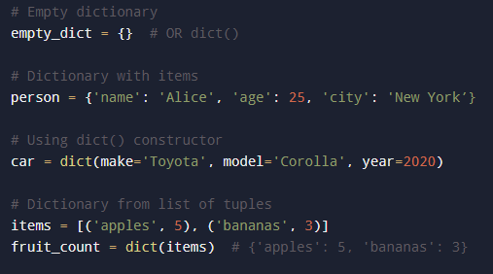

Creating a Dictionary in Python
Use Curly Braces {}or dict()Function
Trust but verify
Dictionary comprehension allows creating dictionaries from iterables, similar to list comprehensions.
Notes:
How to Create a Dictionary
Creating a dictionary in Python is straightforward. You can use curly braces {} with key-value pairs or the dict() function.
# Empty dictionary empty_dict = {} # OR dict() # Dictionary with items person = {'name': 'Alice', 'age': 25, 'city': 'New York’} # Using dict() constructor car = dict(make='Toyota', model='Corolla', year=2020) # Dictionary from list of tuples items = [('apples', 5), ('bananas', 3)] fruit_count = dict(items) # {'apples': 5, 'bananas': 3} # Dictionary comprehension squares = {x: x**2 for x in range(6)} # {0: 0, 1: 1, 2: 4, 3: 9, 4: 16, 5: 25}
The dictionary comprehension syntax (bottom example) is a powerful way to create dictionaries from iterables, similar to list comprehensions.
Image: Slide number: 40

Slide 49
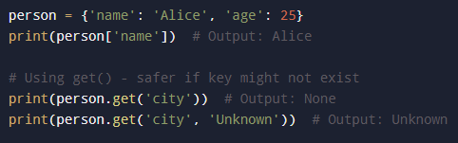
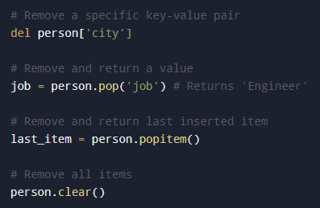
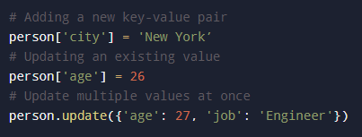
Accessing and Modifying Dictionary Elements
Accessing values
Removing items
Adding & updating
Trust but verify
Notes:
Accessing and Modifying Dictionary Elements
You can access, add, modify, and remove elements in a dictionary using keys:
Accessing Values
person = {'name': 'Alice', 'age': 25} print(person['name']) # Output: Alice # Using get() - safer if key might not exist print(person.get('city')) # Output: None print(person.get('city', 'Unknown')) # Output: Unknown
Adding & Updating
# Adding a new key-value pair person['city'] = 'New York’ # Updating an existing value person['age'] = 26 # Update multiple values at once person.update({'age': 27, 'job': 'Engineer’})
Removing Items
# Remove a specific key-value pair del person['city’] # Remove and return a value job = person.pop('job') # Returns 'Engineer’ # Remove and return last inserted item
last_item = person.popitem() # Remove all items person.clear()
Image: Slide number: 41

Slide 50
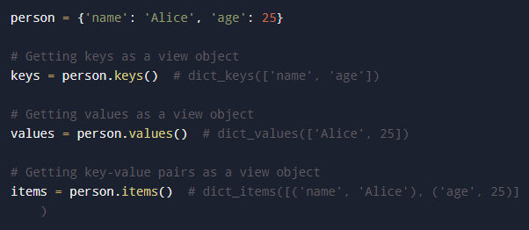
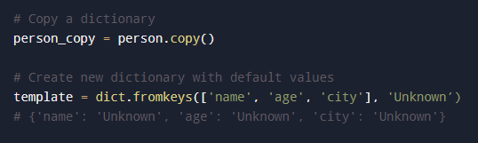
Built- in Dictionary Methods
Trust but verify
Notes:
Dictionary Methods
Dictionaries come with several built-in methods that make data manipulation easy.
person = {'name': 'Alice', 'age': 25} # Getting keys as a view object keys = person.keys() # dict_keys(['name', 'age’]) # Getting values as a view object
values = person.values() # dict_values(['Alice', 25]) # Getting key-value pairs as a view object items = person.items() # dict_items([('name', 'Alice'), ('age', 25)]) # Copy a dictionary person_copy = person.copy() # Create new dictionary with default values template = dict.fromkeys(['name', 'age', 'city'], 'Unknown’) # {'name': 'Unknown', 'age': 'Unknown', 'city': 'Unknown’}

Slide 51

Built- in Dictionary Methods
View objects: keys(), values() and items() return dynamic views that update with dictionary changes.
Trust but verify
Notes:
View Objects: The keys(), values(), and items() methods return dynamic view objects that reflect changes to the dictionary.
person = {'name': 'Alice'}k = person.keys()print(k) # dict_keys(['name'])person['age'] = 25print(k) # dict_keys(['name', 'age'])# The view automatically updates!

Slide 52
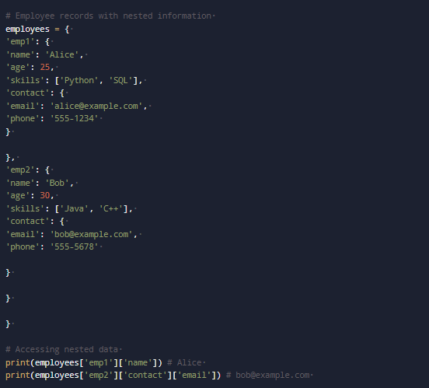
Nested Dictionaries
Dictionaries can contain other dictionaries, forming a nested structure for complex data relationships.
Notes:
Nested Dictionaries
Dictionaries can also contain other dictionaries, creating a nested structure. This is useful for representing more complex data relationships.
# Employee records with nested information employees = { 'emp1': { 'name': 'Alice', 'age': 25, 'skills': ['Python', 'SQL’], 'contact’: { 'email': 'alice@example.com','phone': '555-1234' } }, 'emp2': { 'name': 'Bob’ 'age’: 'skills': ['Java', 'C++'],'contact’: 'email': 'bob@example.com', 'phone': '555-5678' } }}# Accessing nested data
print(employees['emp1']['name']) # Alice print(employees['emp2']['contact']['email']) # bob@example.com

Slide 53




Importance of Nested Dictionaries
Represents hierarchical data
Stores complex objects
Works with JSON-like data structures
Organises related information
Trust but verify
Notes:
Nested dictionaries are perfect for:
Representing hierarchical data
Storing complex objects
Organizing related information
Working with JSON-like data structures
Image:
Infographic Repository Slide 81
Icon 1: https://www.shutterstock.com/image-vector/vector-icon-representing-tree-diagram-aipowered- 2669388295
Icon 2: https://www.shutterstock.com/image-vector/single-black-financial-report-line-icon- 2436811839 icon 3: https://www.shutterstock.com/image-vector/customisable-real-line-icon-flow-chart- 1666653664
Icon 4: https://www.shutterstock.com/image-vector/data-structure-icon-simple-element-organization- 1641734344

Slide 54
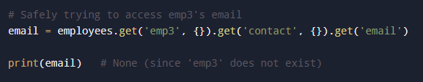
Importance of Nested Dictionaries
Tip
To avoid errors when accessing deeply nested dictionaries, use the get() method:
Trust but verify
Notes:
Tip: To avoid errors when accessing deeply nested dictionaries, use the get() method:
# Safely trying to access emp3's email email = employees.get('emp3', {}).get('contact', {}).get('email’) print(email) # None (since 'emp3' does not exist)

Slide 55
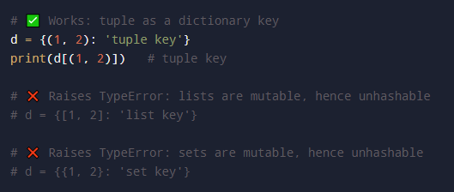
Limitations of Dictionaries
Key restriction: Must be unique and immutable; only immutable tuples are allowed
Trust but verify
Notes:
Limitations of Dictionaries
Key Restrictions
Keys must be unique and immutable (hashable). You cannot use lists, sets, or other dictionaries as keys, though you can use tuples if they contain only immutable elements.
# ✅ Works: tuple as a dictionary keyd = {(1, 2): 'tuple key'}print(d[(1, 2)]) # tuple key# ❌ Raises TypeError: lists are mutable, hence unhashable# d = {[1, 2]: 'list key'}# ❌ Raises TypeError: sets are mutable, hence unhashable# d = {{1, 2}: 'set key’}
Image:
Infographic Repository Slide 85

Slide 56
Limitations of Dictionaries
Memory usage: Uses more memory than lists due to storing keys and values
Order considerations: Insertion order is preserved in Python 3.7+, but not in earlier versions
Trust but verify
Notes:
Memory Usage
Dictionaries typically consume more memory than lists or tuples for the same amount of data, due to their hash table implementation and the overhead of storing both keys and values.
Order Considerations
While dictionaries preserve insertion order in Python 3.7+, this was not true in earlier versions. Code that relies on dictionary ordering might not work with older Python versions.
Image:
Infographic Repository Slide 85

Slide 57
Python Conditional Statements
(Topic 7 of 12)

Slide 58
Conditional Statements in Python
Key Reasons
Programmes need to make decisions
Execute different code based on conditions
For example:
If a student's score ≥ 50 → Pass
Else → Fail
Notes:
Why Conditional Statements?
Programs need to make decisions
Run different code based on conditions
Example:
If a student's score ≥ 50 → Pass
Else → Fail
https://enterprise.shutterstock.com/catalog?q=python

Slide 59

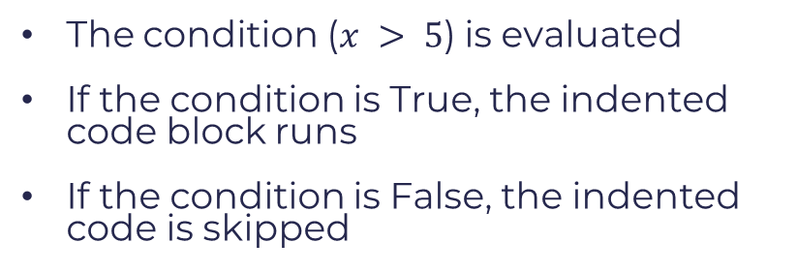
The if Statement
The condition ($x > 5$) is evaluated
If the condition is True, the indented code block runs
If the condition is False, the indented code is skipped
Notes:
The if Statement
x = 10if x > 5: print("x is greater than 5")
Explanation:
The condition (x > 5) is evaluated
If the condition is True, the indented code block runs
If the condition is False, the indented code is skipped
Image: Slide number: 47

Slide 60
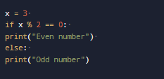
The if-else Statement
Condition check: Evaluate if x % 2 == 0
Decision point: Based on True/False result
Execution: Run either the if block or the else block
The if-else statement gives two paths, ensuring one block always executes
Notes:
The if- else Statement
x = 3 if x % 2 == 0 print("Even number") else: print("Odd number")
Condition Check
Evaluate if x % 2 == 0
Decision Point
Based on True/False result
Execution
Run either the if block or the else block
Key Point: The if-else statement provides exactly two possible paths for your code to follow, ensuring that one of the blocks will always execute.
Image: Slide number: 48

Slide 61
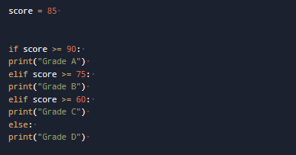
The if-elif-else Statement
Check conditions from top to bottom
Execute the first block that evaluates to True
Skip remaining checks once a match is found
Run the else block only if all conditions are False
Notes:
The if-elif-else Statement
score = 85 if score >= 90: print("Grade A") elif score >= 75: print("Grade B") elif score >= 60 print("Grade C") else: print("Grade D")
Explanation:
Conditions are checked in order from top to bottom
The first condition that evaluates to True will execute its code block
Once a matching condition is found, all other conditions are skipped
The else block executes only if all conditions are False
Image slide number: 49

Slide 62
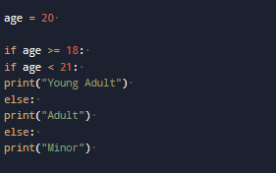
Nested if Statements
Check outer and inner conditions to build layered logic
Risk reduced readability with deep nesting
Prefer flattening logic using if-elif-else when possible
Notes:
Nested if Statements
age = 20if age >= 18:if age < 21:print("Young Adult")else:print("Adult")else:print("Minor")
Nested if statements allow you to check for conditions within conditions, creating more complex decision trees in your code.
Use with caution → Deeply nested conditions can reduce code readability and make debugging difficult.
Consider using if-elif-else chains when possible for better readability. Flatten your logic whenever you can.
Image: Slide number: 50

Slide 63
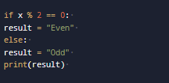

Conditional Expressions (Ternary Operator)
Standard if-else
Use the ternary operator for simple, one-line decisions
Assign values clearly without full if-else blocks
Ternary operator
Notes:
Conditional Expressions (Ternary Operator)
Standard if-else
if x % 2 == 0:result = "Even"else:result = "Odd"print(result)
Ternary Operator
result = "Even" if x % 2 == 0 else "Odd"
The ternary operator provides a compact syntax for simple if-else conditions, making your code more concise.
This is especially useful when assigning values based on conditions or for simple expressions where readability isn't compromised by the condensed format.
Image: Slide number: 51

Slide 64


Logical Operators in Conditions
and
or
not
Returns true only if both conditions are True
Returns True if at least one condition is True
Reverses the boolean value of a condition
Logical operators combine conditions for more complex decision-making.
Notes:
Logical Operators in Conditions
And
Returns True only if both conditions are True
if x > 10 and x < 20:
Or
Returns True if at least one condition is True
if x < 5 or x > 15:
Not
Reverses the boolean value of a condition
if not (x == 10):
Logical operators allow you to combine multiple conditions into a single expression, enabling more complex decision-making in your code.

Slide 65
Common Mistakes to Avoid
Using = instead of == for comparison
if x = 5: (assignment) vs. if x == 5: (comparison)
Forgetting indentation:
Python uses indentation to define code blocks, unlike languages with braces.
Overusing nested if statements:
Complex nested conditions make code harder to read and maintain.
Confusing boolean expressions
Using if x when you mean if x is not None or if x != 0
Notes:
Common Mistakes to Avoid
Using = instead of == for comparison
if x = 5: (assignment) vs. if x == 5: (comparison)
Forgetting indentation
Python relies on indentation to define code blocks, unlike languages that use braces
Overusing nested if statements
Complex nested conditions make code hard to read and maintain
Confusing boolean expressions
Using if x when you mean if x is not None or if x != 0
Remove the icons from the infographics
Repository Slide no: 85

Slide 66
Loops in Python: Automating Repetitive Tasks
(Topic 8 of 12)

Slide 67
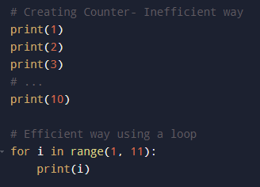
Purpose of Loops
The Problem: Repetition
Use loops to repeat actions efficiently without writing code multiple times.
Notes:
Why Use Loops?
The Problem: Repetition
Without loops, you'd need to write the same code multiple times:
# Creating Counter- Inefficient wayprint(1)print(2)print(3)# ...print(10)# Efficient way using a loopfor i in range(1, 11): print(i)
Loops solve this by allowing you to execute code blocks repeatedly with different values, making your code more efficient, readable, and maintainable.
# Efficient way using a loopfor i in range(1, 11): print(i)
Image: Slide number: 55

Slide 68



Types of Loops in Python
for Loop
while Loop
Nested Loops
Iterates over sequences like lists, strings or ranges
Use when the number of iterations is known
Repeats while a condition is True
Use when the number of iterations is unknown
Loops inside other loops
Use when working with multi-dimensional data or complex patterns
Notes:
Types of Loops in Python
for Loop
Iterates over sequences like lists, strings, or ranges
Use when: You know exactly how many iterations you need
for item in sequence: # code to repeat
while Loop
Repeats as long as a condition remains True
Use when: You don't know the exact number of iterations in advance
while condition: # code to repeat
Nested Loops
Loops inside other loops
Use when: Working with multi-dimensional data or complex patterns
for outer in sequence: for inner in another: # code to repeat
Image: Slide number 56

Slide 69

The for Loop: Iterating Over Sequences
Iterates through a sequence, running the code block for each item
Ideal for processing each element without using indices or counters
Notes:
The for Loop: Iterating Over Sequences
The for loop directly iterates through each item in a sequence, executing the indented code block once per item.
fruits = ["apple", "banana", "cherry"]for fruit in fruits: print(fruit)
This approach is perfect when you need to process each element in a collection without worrying about indices or counters.
Image : Slide number: 57

Slide 70
Using range() with for Loops
The range() Function
Generates a sequence of numbers for iteration
range(stop) - 0 to stop-1
range(start, stop, step) - with custom increments
Notes:
Using range() with for Loops
The range() Function
Generates a sequence of numbers for iteration
range(stop) - 0 to stop-1
range(start, stop) - start to stop-1
range(start, stop, step) - with custom increments
Image:
Infographic Repository Slide 86

Slide 71

Using range() with for Loops
Example
This code will print numbers 1 through 5, stopping before it reaches 6
Output
Generates values on-demand, saving memory
Notes:
Example
for i in range(1, 6): print(i)
This code will print numbers 1 through 5, stopping before it reaches 6.
Output
12345
The range() function is memory-efficient, as it generates values on-demand rather than storing the entire sequence.
Image: Slide number: 58

Slide 72
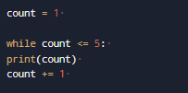

The while Loop: Condition-Based Repetition
Key Functionality
Executes as long as its condition remains True.
Requires a statement to eventually make the condition False.
Warning: Failing to update the loop condition, like omitting $count$ $+= 1,$ creates an infinite loop.
Notes:
The while Loop: Condition-Based Repetition
How It Works
count = 1while count <= 5:print(count) count += 1
A while loop continues to execute as long as its condition evaluates to True. It's critical to include a statement that eventually makes the condition False to avoid infinite loops.
Warning: Always ensure your while loop has a way to terminate! Without count += 1, this example would run forever.
Image: Slide number 59

Slide 73
Loop Control Statements
Continue
Skip the rest of the code and proceed to the next cycle
Break
Break out of the loop and halt iteration
Pass
Proceed with the next step as usual
Notes:
Loop Control Statements
Continue
Skip remainder, go to next iteration
Break
Exit loop immediately and stop
Pass
Do nothing, continue normal execution

Slide 74


Loop Control Statements
Continue Statement
Example:
Output:
Notes:
Example with continue
for i in range(5): if i == 3: continue # Skip 3print(i)
Output:
0124
Image: Slide number 60

Slide 75


Nested Loops: Loops Within Loops
In nested loops, the inner loop completes fully before the outer loop advances.
Output:
Total iterations = outer loop count × inner loop count = 3 × 2 = 6
Notes:
Nested Loops: Loops Within Loops
How It Works
For each iteration of the outer loop, the inner loop runs completely. This creates a pattern where the inner loop completes its cycle before the outer loop advances.
for i in range(1, 4): # Outer loop (rows) for j in range(1, 3): # Inner loop (columns) print(i, j)
Total iterations = outer loop count × inner loop count = 3 × 2 = 6
Output
1 1 1 2 2 1 2 2 3 1 3 2
Image: Slide number: 61

Slide 76

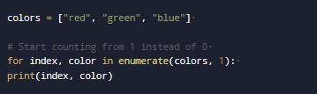
Iterating with enumerate()
The enumerate() function adds a counter to an iterable, returning (index, item) pairs for position-aware iteration.
You can specify a different starting index:
Notes:
Iterating with enumerate() The enumerate() function adds a counter to an iterable, returning pairs of (index, item). This is extremely useful when you need both the position and value during iteration.
colors = ["red", "green", "blue"]for index, color in enumerate(colors): print(index, color)
You can also start from a different index:
colors = ["red", "green", "blue"]# Start counting from 1 instead of 0for index, color in enumerate(colors, 1):print(index, color)
Image: Slide number 62

Slide 77
Mastering Python Loops
Key Takeaways
Use for loops for known sequences and while loops when iterations depend on a condition
Use range() for number sequences and enumerate() to access indices and values
Choose the right loop
Special iterators
Combine loops for multi-dimensional data, while considering performance and complexity
Use break, continue and pass to manage loop execution
Microsoft Autogen
Nested loops
Notes:
Mastering Python Loops: Key Takeaways
Choose the Right Loop
Use for loops when iterating over a known sequence. Use while loops when the number of iterations depends on a condition.
Control Flow Tools
Master break, continue, and pass to control loop execution precisely.
Special Iterators
Use range() for number sequences and enumerate() when you need both indices and values.
Nested Loops
Combine loops for multi-dimensional data, but be mindful of performance as complexity increases.
Remove the icons from the infographics and write the lead in texts inside the box.
Repository Slide no: 31

Slide 78
Building a Simple Chatbot in Python
(Topic 9 of 12)

Slide 79


Building a Simple Chatbot in Python
Objective: Make programmes interactive using conditionals and loops
Scenario: Build a chatbot that greets, answers queries and ends with "bye”
Notes:
Building a Simple Chatbot in Python
Objective
Learn how to use conditionals and loops to make programs interactive
Scenario
A chatbot that:
Greets the user
Answers basic queries (name, time, help)
Keeps running until the user types "bye"
Icon 1:https://enterprise.shutterstock.com/image-vector/action-plan-set-web-icons-line- 2474395423
Icon 2:https://enterprise.shutterstock.com/image-vector/scenario-folder-icon-outline-vector-web- 1878419215
Repository Slide no: 43

Slide 80
Building a Simple Chatbot in Python
Key Concepts Explained
Use a while loop to keep the chatbot active for multiple inputs
Use if-elif-else conditionals to decide responses based on user input
Combine logic and repetition to build real-world applications
Notes:
Explanation
Loop (while) keeps the chatbot active for multiple inputs
Conditionals (if-elif-else) decide responses based on user input
Demonstrates how logic + repetition create real-world applications
Repository Slide no: 91

Slide 81
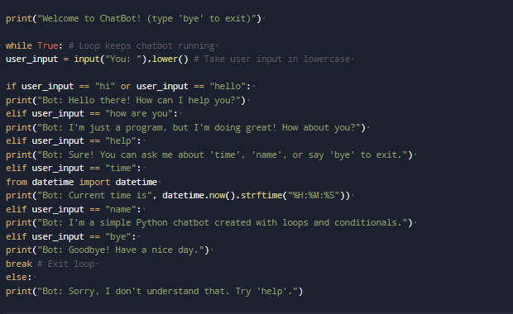
Building a Simple Chatbot in Python
Notes:
print("Welcome to ChatBot! (type 'bye' to exit)")while True: # Loop keeps chatbot running user_input = input("You: ").lower() # Take user input in lowercaseif user_input == "hi" or user_input == "hello“ print("Bot: Hello there! How can I help you?") elif user_input == "how are you": print("Bot: I'm just a program, but I'm doing great! How about you?")elif user_input == "help":print("Bot: Sure! You can ask me about 'time', 'name', or say 'bye' to exit.")elif user_input == "time":from datetime import datetime print("Bot: Current time is", datetime.now().strftime("%H:%M:%S")) elif user_input == "name": print("Bot: I'm a simple Python chatbot created with loops and conditionals.") elif user_input == "bye":print("Bot: Goodbye! Have a nice day.") break # Exit loop else: print("Bot: Sorry, I don't understand that. Try 'help'.")

Slide 82
Recap
(Topic 10 of 12)

Slide 83
Python Fundamentals
Recap
Core data types
Mastered Python's core building blocks: variables, numbers, strings, lists and dictionaries
Variable operations
Learned to declare variables, convert data types and manage user input/output.
Data Structures
Practiced creating and manipulating lists and dictionaries for efficient data organisation and access
Logic & Control Flow
Gained proficiency in writing logic-based branching statements and implementing loops with conditions
Notes:
Python Fundamentals: Building Your Programming Foundation
Recap of Lession
Core Data Types
We explored variables, numbers, strings, lists, and dictionaries—the building blocks of Python programs.
Variable Operations
You learned to declare variables, convert between types, and handle input/output for user interaction.
Data Structures
We practiced creating and manipulating lists and dictionaries to organize and access your data efficiently.
Logic & Control Flow
You mastered writing logic-based branching statements and implementing loops with conditions.
Remove the icons and replace lead in it.
Repository Slide no: 81

Slide 84


Logic Flows in Everyday Life
Programming Mirrors Daily Decisions and Repetition
Conditional logic
If it is raining, take an umbrella
Loops
Process all emails until the inbox is empty
Branching
If the traffic is heavy, take the metro; otherwise, drive
The logic for navigating daily life is the same for writing effective code.
Notes:
Logic Flows in Everyday Life
Every program is built on decisions and repetitions—just like our daily lives. When you understand this connection, programming starts to feel natural.
Conditional Logic
If it's raining → take umbrella
Loops
Process emails until inbox is empty
Branching
If traffic heavy, take metro, else drive
The same logic patterns we use to navigate our world are the foundation of effective programming.
Image:
The icons were taken from the slide deck slide number 69
Repository Slide no: 43

Slide 85
Python User-Defined Functions:
Making code reusable, organised and efficieent
(Topic 11 of 12)

Slide 86



Function
Reusable Blocks Performing Specific Tasks
Promotes code reusability and modularity
Simplifies complexity by breaking problems into smaller tasks
Reduces redundancy and enhances code readability
Notes:
What is a Function?
A function is a reusable block of code that performs a specific task. Think of it like a kitchen appliance, such as a blender, that performs a specific function (blending) when you use it.
Helps in code reusability and modularity
Simplifies complex problems by breaking them into smaller tasks
Reduces redundancy and improves code readability
Image:
Repository Slide no: 81
Icon 1:https://enterprise.shutterstock.com/image-vector/define-vector-icon-set-black-filled- 2552743225
Icon 2:https://enterprise.shutterstock.com/image-vector/set-digital-marketing-line-icons-management- 2476803737
Icon 3:https://enterprise.shutterstock.com/image-vector/convenience-icon-set-quick-service-convenient- 2438255389
Icon 4: https://enterprise.shutterstock.com/image-vector/percentage-growth-decline-icons-percent-arrow- 2334835969

Slide 87


Purpose of Functions
Without Functions
With Functions
Repeat code unnecessarily
Reuse code across tasks
Struggle to maintain logic
Organise related operations
Face difficulty debugging
Improve code readability
Fail to scale effectively
Notes:
Why Do We Need Functions?
Without functions, programs become:
Long and repetitive
Difficult to maintain
Hard to debug
Almost impossible to scale
Repository Slide no: 81
Icon 1: https://www.shutterstock.com/image-vector/green-check-mark-red-cross-icon- 2474370043 (Second icon)
Icon 2:https://www.shutterstock.com/image-vector/green-check-mark-red-cross-icon- 2474370043 (First icon)

Slide 88

Built-in v. User-Defined Functions
Built-in Functions
Provided by Python and ready to use.
Python includes over 60 built-in functions.
Notes:
Built-in vs User-Defined Functions
Built-in Functions
Provided by Python - ready to use!
print("Hello world!") # Output text len([1, 2, 3]) # Count items (returns 3) max(10, 5, 20) # Find maximum (returns 20) round(3.14159, 2) # Round number (returns 3.14
Image: Slide number: 73

Slide 89
Built-in v. User-Defined Functions
User-Defined Functions
Created by the user for specific tasks.
Tailor logic to exact needs
Extend Python’s capabilities
Encapsulate problem-solving steps
Notes:
User-Defined Functions
Created by you for specific tasks
Tailored to your exact needs
Extend Python's capabilities
Encapsulate your problem-solving logic
Image:
Infographic Repository Slide 81

Slide 90
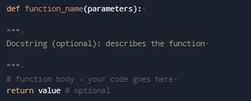
Anatomy of a Function
Def keyword: Indicate the start of a function definition
Function_name: Identify the function using a descriptive name
Parameters: Provide optional inputs for the function
Return statement: Send output back to the caller (optional)
Notes:
Anatomy of a Function
def function_name(parameters):""" Docstring (optional): describes the function """ function body - your code goes here return value # optional
def Keyword
Tells Python you're defining a function
function_name
Descriptive identifier (follows variable naming rules)
parameters
Inputs the function needs (optional)
return statement
Sends output back to caller (optional)
Image: Slide number: 74

Slide 91
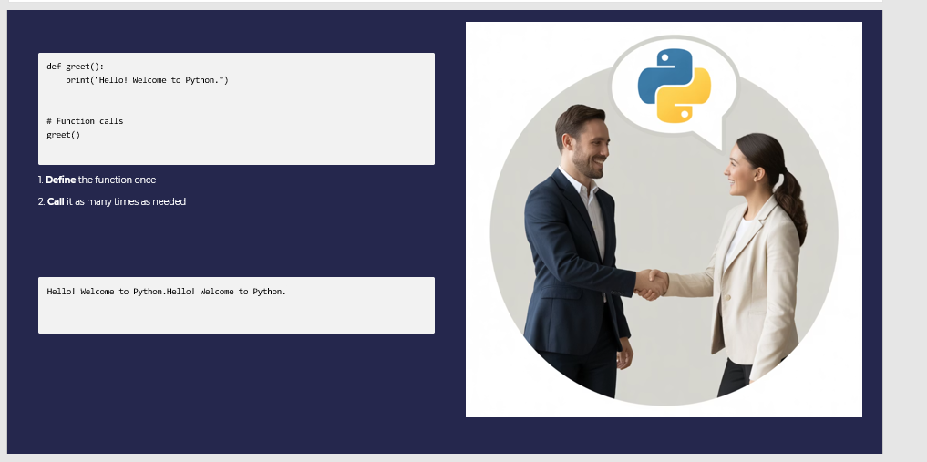
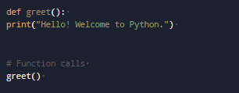
Introducing Functions in Python
Notes:
Define the function once
def greet(): print("Hello! Welcome to Python.")# Function callsgreet()
Call it as many times as needed
Hello! Welcome to Python.Hello! Welcome to Python.
Image: Slide number: 75 (Use the highlighting effect and fade out at the end of each audio cue.)

Slide 92
Function Parameters and Arguments
Defines parameters as placeholders for data
Provides arguments as actual values in a call
Places parameters in the function header
Supports default, keyword and arbitrary arguments
Notes:
Function Parameters and Arguments
Parameters are placeholders for data that you pass into a function, while arguments are the actual data you provide when calling the function.
Parameters are defined in the function header
Arguments are provided when the function is called
Supports default parameters, keyword arguments, and arbitrary arguments
Image
Repository Slide no: 85

Slide 93
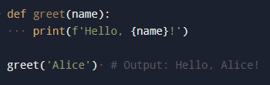
Function Parameters and Arguments
Example
Notes:
For example :
def greet(name):print(f'Hello, {name}!')greet('Alice') # Output: Hello, Alice
Image from : 76
Repository Slide no: 85

Slide 94
Returning Values from Functions
Uses the return statement to pass results back to the caller
Return statement exits the function and optionally sends back a value
If no return statement is used, the function returns None
Notes:
Returning Values from Functions
Functions can return values using the return statement, allowing you to pass the result of the function back to the caller.
return statement exits the function and optionally sends back a value
If no return statement is used, the function returns None
Image: Slide number: 77

Slide 95
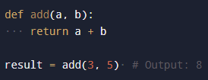
Returning Values from Functions
Example
Notes:
For Example :
def add(a, b):return a + bresult = add(3, 5) # Output: 8
Image: Slide number: 77

Slide 96
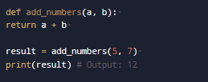
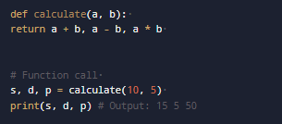
Multiple Parameters & Return Values
Multiple parameters
Multiple return values
Python functions handle multiple inputs and return multiple outputs as tuples.
Notes:
Multiple Parameters & Return Values
Multiple Parameters
def add_numbers(a, b): return a + bresult = add_numbers(5, 7)print(result) # Output: 12
Multiple Return Values
def calculate(a, b): return a + b, a - b, a * b# Function calls, d, p = calculate(10, 5)print(s, d, p) # Output: 15 5 50
Python functions can accept multiple inputs and return multiple outputs as tuples!
Images: slide number 78

Slide 97
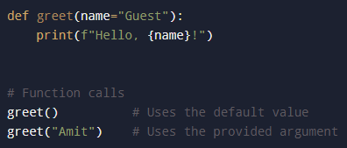

Default Parameters
Example:
Output:
Default parameters add flexibility and simplify function calls.
Notes:
Default Parameters
def greet(name="Guest"):print(f"Hello, {name}!# Function callsgreet() # Uses the default valuegreet("Amit") # Uses the provided argument
Output
Hello, Guest!Hello, Amit!
Default parameters make functions more flexible and user-friendly.
Images: Slide number: 79

Slide 98




Default Parameters
Key Benefits
Makes parameters optional
Provides sensible defaults
Reduces errors
Simplifies function calls
Notes:
Benefits
Makes parameters optional
Provides sensible defaults
Reduces errors
Simplifies function calls
Image: (Remove the arrows from it.)
Repository Slide no: 68
SSID:
Icon 1:https://enterprise.shutterstock.com/image-vector/settings-glyph-solid-icons-collection-containing-247996373
Icon 2:https://enterprise.shutterstock.com/image-vector/solution-provide-icon-vector-logotype-1848576199
Icon 3:https://enterprise.shutterstock.com/image-vector/reduced-error-icon-set-multiple-style-2615661547
Icon 4:https://enterprise.shutterstock.com/image-vector/education-line-drawing-icon-set-simplified-2564876977

Slide 99
*args (Variable Positional Arguments)
Define with asterisk
Double asterisk (**) collects multiple keyword arguments into a dictionary.
Pass any number of arguments
Functions can process an unspecified number of arguments
Access as a tuple
Inside, args is a tuple of all passed values.
Notes:
*args (Variable Positional Arguments)
Define with Asterisk
The asterisk (*) collects multiple arguments into a tuple.
Pass Any Number of Arguments
Function can handle varying numbers of inputs.
Access as a Tuple
Inside the function, args is a tuple containing all passed values.
Image : Slide number: 86

Slide 100

*args (Variable Positional Arguments)
Example
Notes:
For example:
def add_all(*nums): return sum(nums)add_all(1, 2, 3, 4) # Returns 10
Image : Slide number: 80

Slide 101
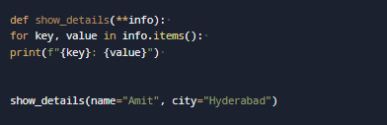
**kwargs (Variable Keyword Arguments)
Use double asterisks (**) to collect keyword arguments into a dictionary:
Notes:
**kwargs (Variable Keyword Arguments)
Use double asterisks (**) to collect keyword arguments into a dictionary:
def show_details(**info): for key, value in info.items():print(f"{key}: {value}")show_details(name="Amit", city="Hyderabad")
Image: Slide number: 81

Slide 102
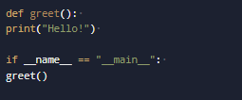
Using if __name__ == "__main__"
Run code conditionally: Runs specific code blocks only if the script is the main program
Create reusable modules: Enables files to function as standalone programs or reusable modules
Prevent Automatic Execution: Code inside the if block won't run when imported
Notes:
Using if __name__ == "__main__"
Run Code Conditionally
Execute certain code only when the file is run directly
Create Reusable Modules
Allow files to serve as both scripts and libraries
Prevent Automatic Execution
Code inside the if block won't run when imported
def greet(): print("Hello!")if __name__ == "__main__": greet()
Image: Slide number 82

Slide 103
Scope of Variables in Functions
Local v. Global Scope
Local scope | Global scope
Variables declared inside a function, accessible only within that function​ | Variables declared inside a function, accessible only within that function​
Notes:
Scope of Variables in Functions
Scope refers to the visibility of variables within different parts of your code. Variables defined inside a function are local to that function and cannot be accessed outside of it.
Local Scope: Variables declared inside a function, accessible only within that function
Global Scope: Variables declared outside of all functions, accessible throughout the code

Slide 104
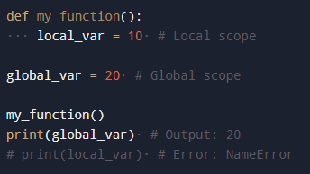
Scope of Variables in Functions
Example
Notes:
For Example:
def my_function():local_var = 10 # Local scope global_var = 20 # Global scope my_function() print(global_var) # Output: 20 # print(local_var) # Error: NameError
Image: Slide number: 83

Slide 105
Exercise: Ticket Pricing Function
Accepts a person's age as its input parameter
Determines the ticket price using conditional logic
Ages under 12: ₹100
Ages 12 to 59: ₹200
Ages 60 and above: ₹150
Outputs the calculated ticket price
Notes:
Exercise: Ticket Pricing Function
Write a Python function called calculate_ticket_price(age) that:
Takes a person’s age as input (parameter).
Uses if statements to decide the ticket price:
If age is below 12, the price is ₹100.
If age is 12 to 59, the price is ₹200.
If age is 60 or above, the price is ₹150.
Returns the final ticket price.
Image:
Repository Slide 86

Slide 106

Lambda Functions
Lambda functions are small, anonymous functions defined with lambda, ideal for short, one-time use.
Example :
Notes:
Lambda Functions
Lambda functions are small, anonymous functions defined with the lambda keyword. They are useful for short, throwaway functions that are not intended to be reused.
For Example :
square = lambda x: x ** 2print(square(4)) # Output: 16
Image : Slide number 85

Slide 107




Best Practices
Add docstrings
Use clear names
Keep functions short
Write test cases
Use docstrings to describe your function's purpose, parameters, and return value
Prefer clear parameter names like user_age over vague ones like x
Design functions to be focused and concise; avoid exceeding a single screen of code
Verify edge cases and unexpected inputs to ensure robust function performance
Notes:
Best Practices
Add Docstrings
Document your functions with triple quotes. Explain parameters and return values.
Use Clear Names
Choose descriptive function names like calculate_mean() instead of cm().
Keep Functions Short
Each function should do one thing well. Aim for under 20 lines.
Write Test Cases
Test functions with various inputs to verify correct behavior.
Image:
Infographic Repository Slide 84 (Show without arrows from it.)
These icons were from slide deck
Repository Slide no: 84

Slide 108
Example: Chatbot with Function
(Topic 12 of 12)

Slide 109
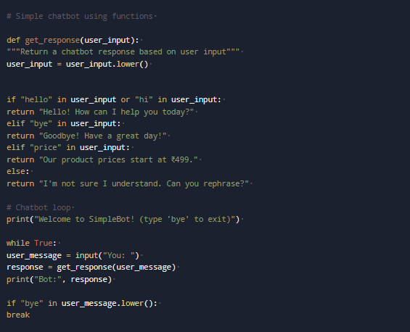
Chatbot: Backend Code Example
Notes:
Chatbot: Backend Code Example
# Simple chatbot using functionsdef get_response(user_input): """Return a chatbot response based on user input"""user_input = user_input.lower() if "hello" in user_input or "hi" in user_input:return "Hello! How can I help you today?" lif "bye" in user_input: return "Goodbye! Have a great day! elif "price" in user_input return "Our product prices start at ₹499." else:return "I'm not sure I understand. Can you rephrase?"# Chatbot loopprint("Welcome to SimpleBot! (type 'bye' to exit)") while True: user_message = input("You: ") response = get_response(user_message) print("Bot:", response) if "bye" in user_message.lower(): break
Image : Slide number 88

Slide 110
Chatbot: Backend Code Example
Process
Get_response function
Encapsulates all reply logic
Determines the response using conditional checks
Main loop
Continuously accepts user input
Invokes get_response(user_message)
Outputs the generated reply
Terminates on the "bye" command
Notes:
How it Works
get_response function:
Encapsulates the chatbot’s logic.
Uses if statements to decide on the reply.
Main loop:
Takes input from the user.
Calls get_response(user_message).
Prints the bot’s reply.
Exits when user types "bye".
Image:
Repository Slide 86

Slide 111
Reflection Activity
Real-World Logic in Daily Life
Take a minute
Identify a specific example of a decision or repetitive process from your experience.
Make it concrete
Frame it as an if-statement or loop, noting conditions and resulting actions.
Share
Record or share your example to reinforce the connection between real-world logic and code.
Notes:
Reflection Activity
Where do you use logic flows in your daily work or personal life?
Take a Minute
Think of one specific example from your own experience—a decision tree or repetitive process you follow.
Make It Concrete
Try to frame it as an if-statement or loop. What conditions do you check? What actions result?
Share
Write it in your notes or share with the class—translating real-world logic to code reinforces today's concepts.
This reflection helps bridge the gap between abstract programming concepts and your everyday experience!
Image:
Repository Slide no: 91

Slide 112
Q & A

Slide 113
Thank you

